Slide 1
Data Attributes & Event Delegation
Front-End Web Development

Slide 2
Data Attributes and Event Delegation
Overview
This lesson introduces data attributes, event delegation and the target property.
This is a bonus flex lesson that will help students write less repetitive JavaScript.
Learning Objectives
In this lesson, students will:
Use data attributes to store additional custom information on HTML elements.
Learn about event bubbling and event delegation in JavaScript.
Use event.target and data attributes to create one event handler for multiple elements.
Duration: 40 minutes

Slide 3
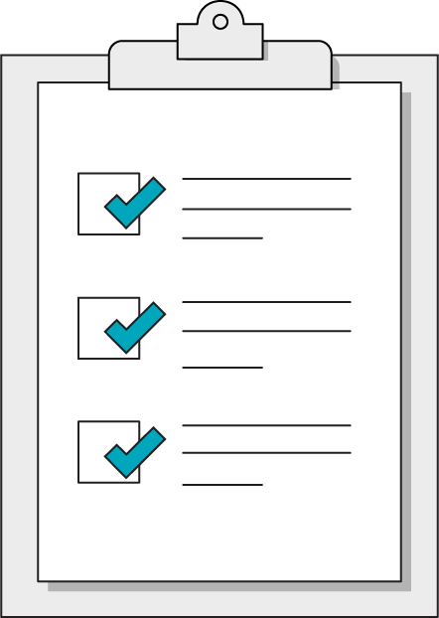
Today’s Learning Objectives
In this lesson, you will:
Learn the syntax of data attributes in HTML elements and how to retrieve them in JavaScript.
Write fewer event handlers using event delegation and event bubbling.
‹#› | © 2020 General Assembly

Slide 4
Data Attributes
Front-End Web Development

Slide 5
Data Attributes
We can add custom data-* attributes to any HTML element to provide additional information to our JavaScript when we select a DOM element.
Data attributes are accessible in our JavaScript via the dataset object on an HTML element.
15 minutes

Slide 6
Data Attributes Example
Data Attributes Example
https://codepen.io/pdoulatshahi/pen/BapLMxM

Slide 7
Event Delegation
Front-End Web Development

Slide 8
Event Delegation
Events bubble up in JavaScript. What does this mean?
When you listen for an event on a parent element and the event takes place on a child element of that parent, the event bubbles up to that parent element and the event callback function is called.
15 minutes

Slide 9
Event Delegation
You can use just one event listener function on a parent element to listen for events on one or more children.
Less JavaScript code! Less repetitive code!
For example, you can listen for a click on the document and then check the event.target property in your event callback function - this will be the specific element the user clicked.
15 minutes

Slide 10
Event Delegation Example
Event Delegation Example
https://codepen.io/pdoulatshahi/pen/ExZgrOm

Slide 11
Traffic Light: Event Delegation
25 minutes
Let’s revisit our Traffic Light activity from earlier on in the course.
Notice that we wrote 3 separate event listener functions, with very similar functionality:
One light element is “turned on” and the remaining light elements are “turned off.”
Instead of writing 3 separate event listener functions, we’ll use selector/class strings stored in data attributes to tell our JavaScript:
What element “light” should we turn on?
What class are we adding to this element?

Slide 12
Traffic Light: Event Delegation
25 minutes
When the document is clicked, we’ll check the specific element we clicked using the event.target property.
We’ll run our light changer function only if the clicked element has a specific class.
That function will then retrieve 2 things from the clicked element, both stored in data attributes:
The selector of the light element we want to turn on
The class we want to add to that light element

Slide 13
Traffic Light: Event Delegation
25 minutes
Starter code:
https://codepen.io/pdoulatshahi/pen/gOLmQOr
Solution code:
https://codepen.io/pdoulatshahi/pen/VwmpERJ

